Slide 1

Software Engineering (CS3201) Process Models
Avinash

Slide 2

Software Process
:Definition Phase: (Specification)
Requirements Definition and Analysis:
Developer must understand – Application Domain, Required Functionality, Required Performance, User Interface (might require one or several meetings with client)
Project Planning – Allocate resources, Estimate costs, Define work tasks, Define schedule
System Analysis – Allocate system resources to hardware, software, users, etc.
:Design Phase:
Software Design:
High-level Design – Define modular components (classes, interfaces), Define data structures
Detailed Design – how reach component works internally (functions/ interfaces, etc.), tables designed, Algorithm and logic design, sequence and interaction design, constraints
:Development Phase:
Coding:
Develop code for each module, Unit Testing
Integration:
Combine modules, System Testing
Notes:
High-level design says what components exist and how they interact, Detailed design says how each component works internally.

Slide 3
Software Process
:Validation:
Requirements Analysis and Test Case development, Test Case Execution and Defect Tracking
Types - System Integration Testing (how software interacts with other software); User Acceptance Testing (tests if it works as per user req.); Quality Assurance Testing (meets quality standards)
:Software Evolution: (Maintenance)
Correction – Fix Software defects
Adaptation – Accommodate changes and new features (and new company policy)
Enhancements – new features
Prevention – Identify areas to improve software and make it more maintainable
:Umbrella Activities:
Reviews – Assure Quality (Documents review, Code review, etc.)
Documentation – Improves communication across teams and maintainability
Version Control – Track changes
Configuration Management – track of various versions and associated documentation
Notes:
#1 is not a great start

Slide 4
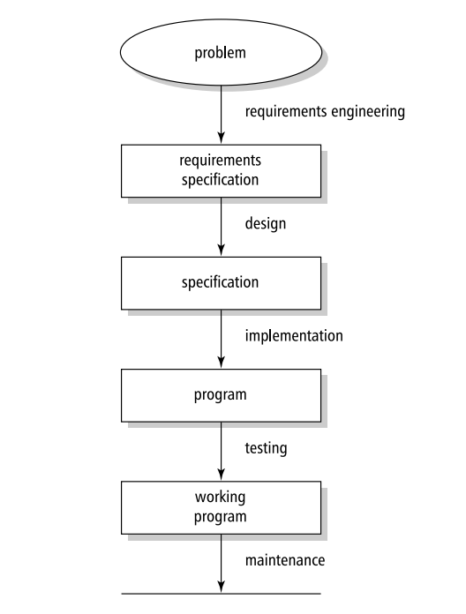
Software Process
Hans Van Vliet, 3rd Ed.
Notes:
#1 is not a great start

Slide 5
Software Engineering Fundamentals
Some fundamental principles apply to all types of Software system, irrespective of the development techniques used:
Systems should be developed using a managed and understood development process. Of course, different types of processes are used for different types of software
Dependability and performance are important for all types of system
Understanding and managing the software specification and requirements (what the software should do) are important
When appropriate, you should reuse software that has already been developed rather than write new software
Notes:
#1 is not a great start

Slide 6
Case study 3 – A wilderness weather station
Classwork
Role play (tentative) – Mimic the people involved and the artefacts needed throughout the entire software lifecycle towards delivery of efficient working product

Slide 7
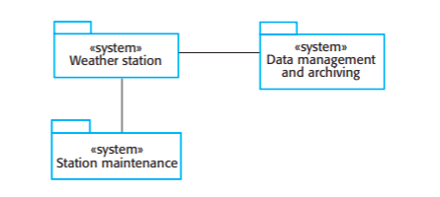
Case study 3 – A wilderness weather station
UML Package Diagram showing the systems in the Software, where each system is a collection of components – for instance, classes.

Slide 8
Case study 3 – A wilderness weather station
The weather station system: This system is responsible for collecting weather data, carrying out some initial data processing, and transmitting it to the data management system
The data management and archiving system: This system collects the data from all of the wilderness weather stations, carries out data processing and analysis, and archives the data in a form that can be retrieved by other systems, such as weather forecasting systems
The station maintenance system: This system can communicate by satellite with all wilderness weather stations to monitor the health of these systems and provide reports of problems. It can update the embedded software in these systems. In the event of system problems, this system can also be used to remotely control weather station

Slide 9
Case study 3 – A wilderness weather station
Requirements:
People involved – Primary stakeholders (Project Sponsors, End users); Secondary stakeholders (Regulatory authorities, Local community representatives); Technical team (Project Manager, Systems Architect, Hardware Engineers, Software Developers, Network Engineers, Data Analysts); Operations specialists (Deployment and Maintenance teams, IT security); Cross Discipline experts (Environmental scientists, GIS experts)
Use documents, mockups, prototypes, user stories, etc. to aid communication. Can have a requirements gathering workshop (with agenda, objective and plan in place to draw up requirements)

Slide 10
Case study 3 – A wilderness weather station
Design:
People involved – Core Design team (System Architect, hardware engineers, software engineers – backend developer, frontend developer, network engineers, data analysts, UI/UX designers), Support team (Project manager, environmental scientists, deployment and maintenance teams, IT security team)
By now, I think you are able to appreciate or get a flavor of what goes into software development on a large scale

Slide 11
Case study 3 – A wilderness weather station
Now let's look at testing (an example to give a better idea)
Testing:
Unit Testing: Individual components like sensor readings, transmission, storage
Integration Testing: How sensors interact with each other and server
System Testing: Deploy in controlled environment and test end-to-end
Performance Testing: Performance under stress (high loads)
Field Testing: Deploy prototype in real world and test
Failover and Recovery Testing: Simulate failures to see how system deals with failure (how it recovers from a power failure, for instance)

Slide 12
Case study 3 – A wilderness weather station
Document showcasing a structured approach needed to designing, implementing and deploying the wilderness weather station: See here

Slide 13
Summary of Software Engineering Process
Requirements Analysis
Design
Coding / Implementation
Validation / Testing
Maintenance

Slide 14
Maintenance
"A family friend retired after being a COBOL programmer for 30 years. About two years after his retirement, a company came to him and said, 'Name your salary,' and he requested around $1.5 million/year. He was hired on the spot and still works there.“
"Pick an obscure programming language, write lots of important code, and don’t comment or document anything.“
Source: https://www.buzzfeed.com/andyneuenschwander/people-are-sharing-what-their-wealthiest-friend-does-for

Slide 15
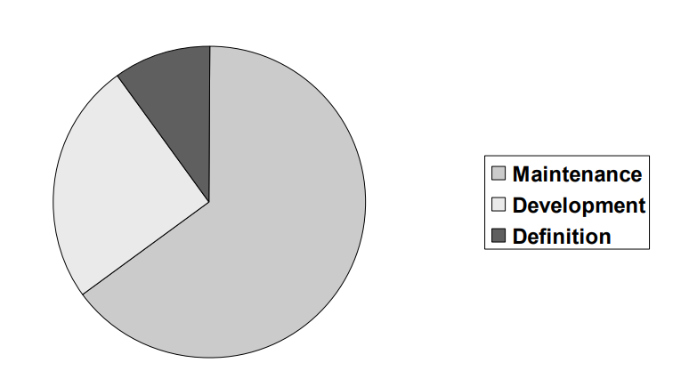
Software Engineering Costs
Figure source: SE CS3204, Raghu Kisore, MEC, 2024

Slide 16
Process Models

Slide 17
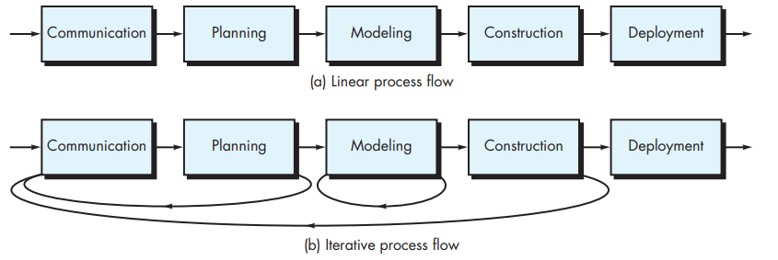
Generic Process Models / Process Flows (Refer Pressman, pg. 33)
!!! Though Pressman uses the term Process flows, I would you rather NOT USE the term Process flow, since it can be misunderstood for 'flow or usage pattern of a software'. !!!

Slide 18
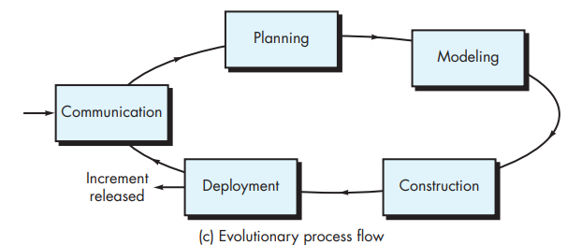
Generic Process Models / Process Flows (Refer Pressman, pg. 33)

Slide 19
Software Engineering Process Models
As explained earlier, a software process model (sometimes called a Software Development Life Cycle or SDLC model) is a simplified representation of a software process
In this section, we introduce a number of very general process models (sometimes called process paradigms) and present these from an architectural perspective. That is, we see the framework of the process but not the details of process activities
These can be thought of as process frameworks, and can be extended and adapted to create more specific software engineering processes
There is no universal process model which works for all kinds of software development

Slide 20
Software Engineering Process Models
Types:
The waterfall model: This takes the fundamental process activities of specification, development, validation, and evolution and represents them as separate process phases such as requirements specification, software design, implementation, and testing
Incremental development: This approach interleaves the activities of specification, development, and validation. The system is developed as a series of versions (increments), with each version adding functionality to the previous version
Integration and configuration: This approach relies on the availability of reusable components or systems. The system development process focuses on configuring these components for use in a new setting and integrating them into a system

Slide 21
Software Engineering Process Models
Many practical software projects tend to combine the best bits from different general models (previous slide)
Attempts have also been made to come up with an universal process model, the best known among these is the Rational Unified Process – RUP
RUP can be modified in different ways such that can resemble any of the general models
Adopted by some companies, notably IBM, but not widespread

Slide 22
Waterfall Model (Refer Sommerville, pg. 47)
Derived from large military systems engineering
Plan driven process – you plan and schedule in advance
Stages of Waterfall model directly reflect the fundamental software engineering activities
Result of each phase is one or more documents which are “signed off” (approved). The next phase does not start until the previous phase completes
This approach works better for hardware solutions, but is not practical (at least in most cases) for software solutions
Notes:
For hardware development, where high manufacturing costs are involved, this makes sense. However, for software development, these stages overlap and feed information to each other. During design, problems with requirements are identified; during coding design problems are found, and so on. The software process, in practice, is never a simple linear model but involves feedback from one phase to another

Slide 23
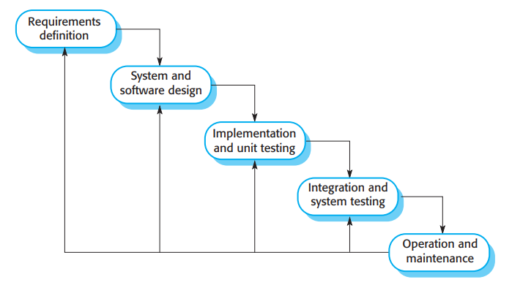
Waterfall Model

Slide 24
Waterfall Model
Drawbacks:
Sequential flow from stage to stage rarely possible, especially hard to envisage the end product in the requirements analysis stage
No option to come back and modify, forces teams to freeze prematurely at different stages
When to use:
Only in situations where – Requirements well understood, Technology is stable, No ambiguity at any stage
Example usage:
Embedded Systems
Critical Systems
Notes:
Example usage of waterfall model:
Embedded systems where the software has to interface with hardware systems. Because of the inflexibility of hardware, it is not usually possible to delay decisions on the software’s functionality until it is being implemented.
Critical systems where there is a need for extensive safety and security analysis of the software specification and design. In these systems, the specification and design documents must be complete so that this analysis is possible. Safety-related problems in the specification and design are usually very expensive to correct at the implementation stage.

Slide 25
Incremental Development (Refer Sommerville, pg. 49)
Incremental development is based on the idea of developing an initial implementation, getting feedback from users and others, and evolving the software through several versions until the required system has been developed
Therefore, here, specification, development and validation are interleaved, rather than separate, with rapid feedback across activities
Incremental development reflects the way that we solve problems. We rarely work out a complete problem solution in advance but move toward a solution in a series of steps, backtracking when we realize that we have made a mistake. By developing the software incrementally, it is cheaper and easier to make changes in the software as it is being developed
Notes:
Each increment or version of the system incorporates some of the functionality that is needed by the customer. Generally, the early increments of the system include the most important or most urgently required functionality. This means that the customer or user can evaluate the system at a relatively early stage in the development to see if it delivers what is required. If not, then only the current increment has to be changed and, possibly, new functionality defined for later increments

Slide 26
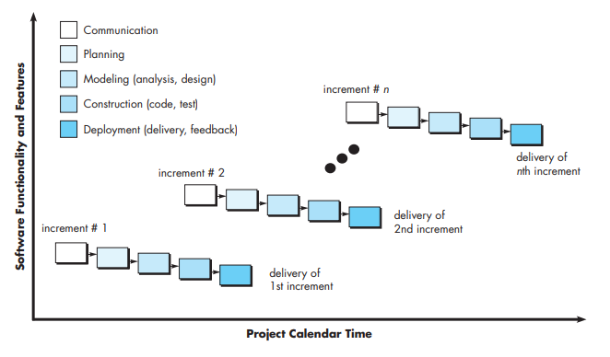
Incremental Model (Refer Pressman, pg. 43)

Slide 27
Incremental Development
Major advantages over waterfall:
Cost of implementing requirements changes is reduced
Easier to get customer feedback on tangible work (customer can give better feedback on a working prototype than on a set of documents)
Early delivery and deployment of “useful” software is possible, customers gain value faster from the software
Drawbacks (managerial):
Process not visible, therefore difficult to track (and since versions are developed quickly, it is not viable to produce documents for every version)
System structure tends to degrade as new features are added (however, agile methods suggest that you regularly refactor, i.e., improve and restructure, the software
Notes:
The problems of incremental development become particularly acute for large, complex, long-lifetime systems, where different teams develop different parts of the system. Large systems need a stable framework or architecture, and the responsibilities of the different teams working on parts of the system need to be clearly defined with respect to that architecture. This has to be planned in advance rather than developed incrementally. Incremental development does not mean that you have to deliver each increment to the system customer. You can develop a system incrementally and expose it to customers and other stakeholders for comment, without necessarily delivering it and deploying it in the customer’s environment. Incremental delivery (covered in Section 2.3.2) means that the software is used in real, operational processes, so user feedback is likely to be realistic. However, providing feedback is not always possible as experimenting with new software can disrupt normal business processes.

Slide 28
Integration and Configuration (re-use) (Refer Sommerville, pg. 52)
Informally, there is some amount of software reuse always (regardless of process type)
Reuse-oriented approaches rely on a base of reusable software components and an integrating framework
Three types of software components are frequently reused: Stand-alone application systems, collection of objects as part of a component or package, web services developed following some standard and can be accessed by remote invocation over the Internet

Slide 29
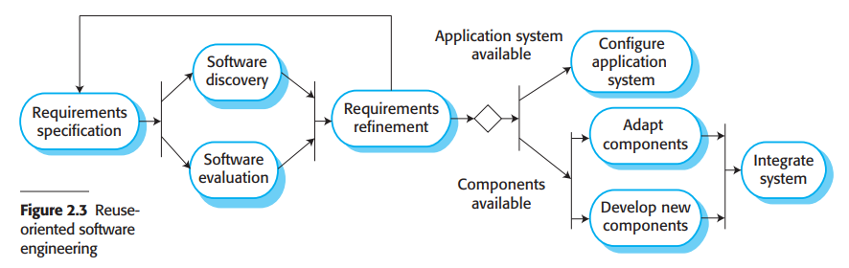
Integration and Configuration (re-use)

Slide 30
Integration and Configuration (re-use)
Stages:
Requirements Specification: Initial requirements proposed. These do not have to be elaborated in detail but should include brief descriptions of essential requirements and desirable system features
Software discovery and evaluation: A search is made for components and systems that provide the functionality required. Candidate components and systems are evaluated
Requirements refinement: During this stage, the requirements are refined using information about the reusable components and applications that have been discovered
Application system configuration: If an off-the-shelf application system that meets the requirements is available, it may then be configured for use to create new system
Component adaptation and integration: If there is no off-the-shelf system, individual reusable components may be modified, then integrated to create the system

Slide 31
Examples on each of the process models
Sample software engineering examples utilizing each of the three process models can be found here: Additional handouts

Slide 32
Additional Models (based on the 3 paradigms)
V model
Evolutionary Process Models
Prototyping Model
Spiral Model
Notes:
Note: Incremental process model is also an evolutionary model.

Slide 33
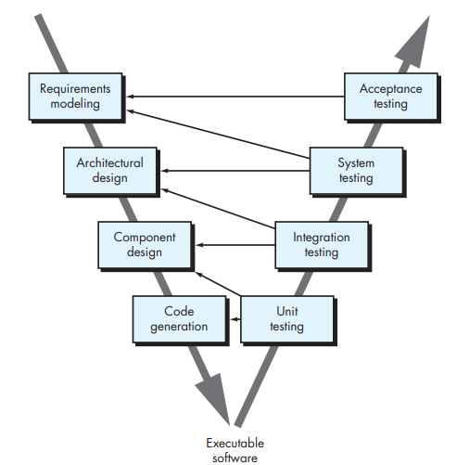
V Model (Refer Pressman, pg. 42)
Wait, what is happening here?!
Do other models not focus on testing? How is V different?
It integrates testing ALONGSIDE each phase of process lifecycle.
Just look at the left arm (or leg) of the V, and it is nothing but your simple waterfall model.
How do you test requirements modelling? Here, testing does not happen in a conventional sense, rather you do something like requirements review, where documents are verified across all stakeholders. You could also start developing test cases and work on Requirements Traceability Matrix (RTM)
The right arm (or leg) of the V symbolizes the fact that the V model focuses on testing artefacts produced at every single stage / phase of project lifecycle.

Slide 34
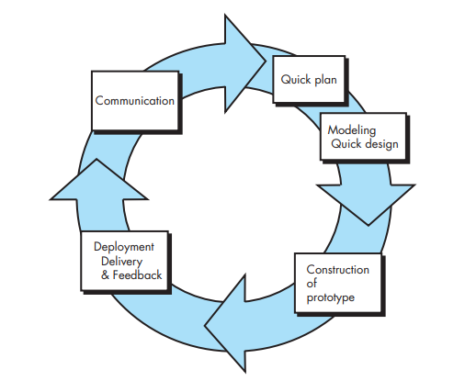
Prototyping Model (Refer Pressman, pg. 45)
Oi! Whats happening here?! Is this life? (maybe it is, maybe it isn't – refer Parminedes and Neitzsche)
General life cycle of a prototype:
-Understand the Basics
-Build a simple version (prototype)
-Get feedback
-Improve the prototype
-Build the final product
Okay, so coming back, prototyping involves building a quick prototype (simple version of software), to gather ideas and feedback, and get a consensus on the product before building it in detail.
One gray area in this process is what one can do with the prototype? Do we build on top of it, or build the final product from scratch. In my experience, prototypes do not follow rigor while building, and then it becomes risky to build final product on top of prototype (but that is just my 2 cents)

Slide 35
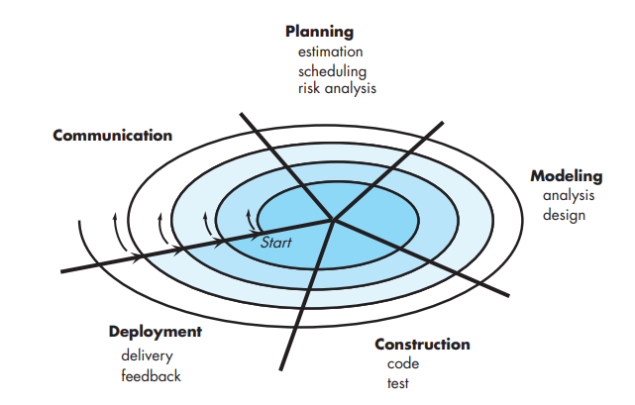
Spiral Model (Refer Pressman, pg. 45)
Building software step by step, focusing on reducing risks and improving the product as you go. It’s like combining planning, building, and testing in small loops (or spirals) until the software is finished. Each loop adds more details and features to the software
Okay, now what? A vinyl?
Think of it as baking a cake? First build the base, if it tastes okay, add a layer on top of it, and so on. Unlike prototyping, every intermediate product is well executed and follows engineering rigor.
Then how it is different from incremental?
Here, there is a lot of focus on risk analysis and management.
Risk analysis is the process of identifying, evaluating, and prioritizing potential problems or uncertainties in a project to minimize their impact.
The crucial difference between this model and the others is that here, 'Risk Analysis' happens in 'Planning' stage

Slide 36
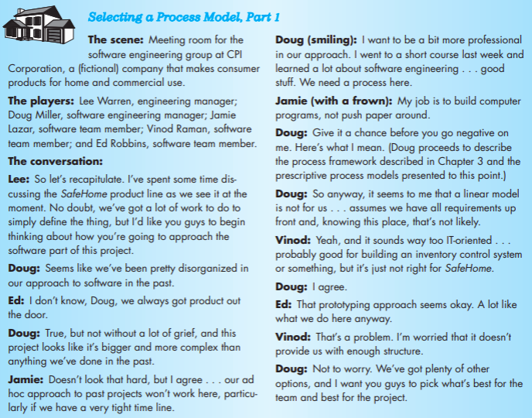
Selecting a process model (Pressman pg. 47)

Slide 37
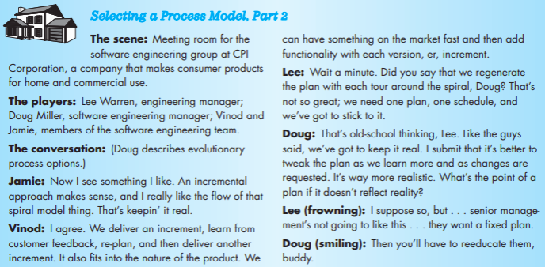
Selecting a process model (Pressman pg. 50)

Slide 38
Agile Processes
Next set of slides

Slide 39
Cue cards: Which Software Process to use
Waterfall model: Best for projects with clear requirements, fixed scope and predictable timelines.
Spiral Model: Used for high-risk projects where thorough risk assessment and mitigation are crucial.
Iterative Model: Suitable for complex projects where requirements may change during development, allowing for incremental refinement.
V-model: Emphasizes rigorous testing at each development phase, ensuring high quality software.
I & C Model: When system can be built using reusable components, when time is critical, requirements are well defined, and minimal custom development.
Agile Model: Ideal for projects with evolving requirements, frequent customer feedback, and a need for flexibility.

Slide 40
Thank you!

